Slide 1
Learned Inverted Index
Antonio Mallia
Yair Schiff
Yves Greatti
Deep Learning
Prof. Yann LeCun
Spring 2019
Notes:
Hello our names are Antonio, Yair and Yves and together we will be presenting our project ”Learned Inverted Index”

Slide 2
Background: Inverted Index data structure
C
A
B
A
Corpus consists of documents
B
Unique terms are extracted
C
For each term, a “posting list” is created = sorted sequence of document IDs that contain the term
Most search engines rely on this inverted index data structure
With millions of documents and terms, table memory footprint is significant, so better compression techniques are critical
Notes:
To provide some background about the domain we explored, we investigated the inverted index data structure
An inverted index is the key data structure used in most current large-scale text search systems.
It is composed of posting lists, one for each distinct term in a collection.
A posting list is a sequence of the IDs of the documents containing the corresponding term
Given the extremely large collections indexed by current search engines, finding better compression schemes is a critical task

Slide 3
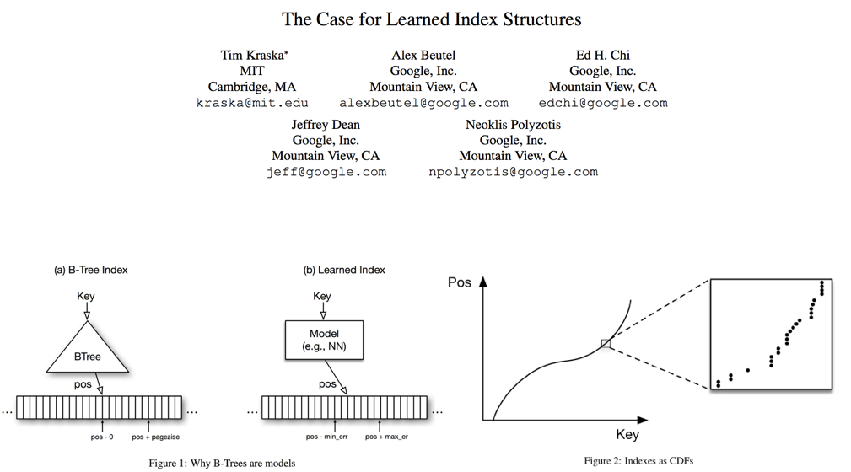
Previous work & motivation: Learned index structures
Kraska et al. (2016) provide groundbreaking work illustrating usage of deep learning in modeling indexed data structures (e.g. B-Trees)
Our work builds on this result to extend learned index structures to inverted indexes
Notes:
The main motivation for our project is the work of Kraska et al from 2016
In their work, the authors propose a novel and somewhat surprising approach of viewing dictionaries as functions that map indices to values, and therefore can be learned with machine learning models such as Neural Networks
Inspired by this work, we aim to expand these authors’ approach to learning inverted indexes

Slide 4
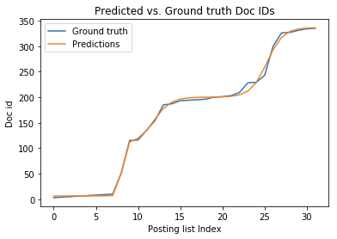
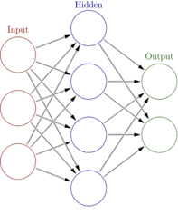
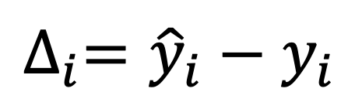
Methodology
Feed indexes of posting lists to NN models
Predict doc IDs
Goal:
$$∆_{i}={\hat{y}}_{i}−y_{i}$$
Compressed model weights and errors should have smaller memory footprint than compressed versions of actual posting lists
Compress model weights and errors to reduce memory footprint
Store errors between ground truth & predictions for every index
Notes:
Our main goal is to reduce the memory footprint of the final representation of the inverted index
Although several compression schemes already exist, we believe that deep learning methods have the potential to beat these techniques.
To explore this hypothesis we used Neural Network models to predict the document ID distribution of individual posting lists.
With unlimited capacity the networks could easily memorize the posting lists, however given our aim of memory reduction we are constrained to smaller networks.
To represent the posting lists, we save the model weights which can be used at inference time to re-produce posting lists.
In order to recreate the lists with lossless compression, we also store the errors between ground truth document IDs and our models’ predictions.
The ultimate objective is to see if the compressed model weights and errors that we store can achieve smaller memory footprint than compressed representations of the original data structure

Slide 5
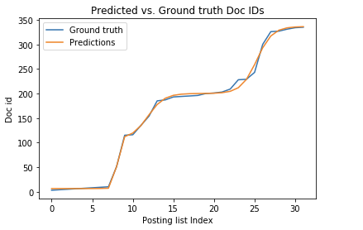
Training: Using shallow feed-forward network we are able to learn posting list structures
Even with a simple NN, when breaking up a posting list into batches of document IDs (e.g. 32, 64), accuracy of predicted document IDs is high
Other approaches explored:
Intra-posting list clustering: Use k-means to cluster document IDs within a posting list into batches of similar segments
RNN (LSTM & GRU): Use index-to-doc (input = index) and doc-to-doc (input = previous document ID) in conjunction with recurrent model
Notes:
As mentioned above, given our constraint to models with fewer weights, the models we employed were not able to generalize to entire posting lists.
In order to overcome this limitation, we elected to split each posting list into smaller batches and use one model per batch.
Thus even though we needed to learn multiple models per posting list, this tradeoff proved useful as can be seen in the plot above, which is representative of the type of results we observed.
In this plot we see that even for a shallow network with 3 hidden units, we are able to accurately fit the document ID distribution of the shown posting list segment
In addition to the shallow network approach, we also experimented with recurrent models and with variable segmentation of posting lists into batches based on k-means clustering. However given the time constraints of the project, our main results center on the shallow feed forward networks

Slide 6
Results: Our approach achieved compression gains
 | Compressed posting lists |  | Our approach* |  |  | Ratio (our approach / compressed posting lists)
Compression scheme | Bits per Doc ID |  | Bits per Doc ID (errors) | Total Bits per Doc ID (accounting for weights)
OptPFD | 5.21 |  | 3.44 | 4.04 |  | 78%
SIMD-BP128 | 7.32 |  | 3.45 | 4.05 |  | 55%
Simple8b | 6.43 |  | 2.32 | 2.92 |  | 40%
* Note: Results here reflect a network with one hidden layer with number of units = length of posting list divided by 40 (and a bias term)
Even accounting for model weights, we are able to achieve improved compression relative to storing compressed posting lists
We currently used 8-bit quantization to compress model weights
Notes:
As seen in the table, we find preliminary results that bode well for learned inverted index structures.
Comparing several compression mechanisms, the memory footprint of our errors is a fraction of the original posting lists.
Even accounting for the footprint of the model weights, we still perform better than compression of the original data structure.
To compress our model weights we used quantization with 8-bits per weight.

Slide 7
Future work
1
Better understand what features of a posting list lend themselves to more accurate model predictions
Find better compression scheme for network weights
Improve RNN-based model to leverage better long term memory
Use hierarchical ensemble modeling [Kraska et al. (2016)] to improve predictions
2
3
4
Notes:
While we found promising results, we recognize that there are several extensions to our work
We found that across posting lists and batches there was variability in how accurate model prediction was.
We would like to explore what features of document ID distributions are more conducive to neural network modelling
Additionally, we only explored quantization of network weights, but would like to test other model weight compression schemes
Thirdly, due to time constraints we were not able to adequately experiment with recurrent neural networks, which we believe could outperform the networks we presented above
Finally, we believe that the hierarchical ensemble models used in Kraska et al have the potential to improve our results

